Slide 1
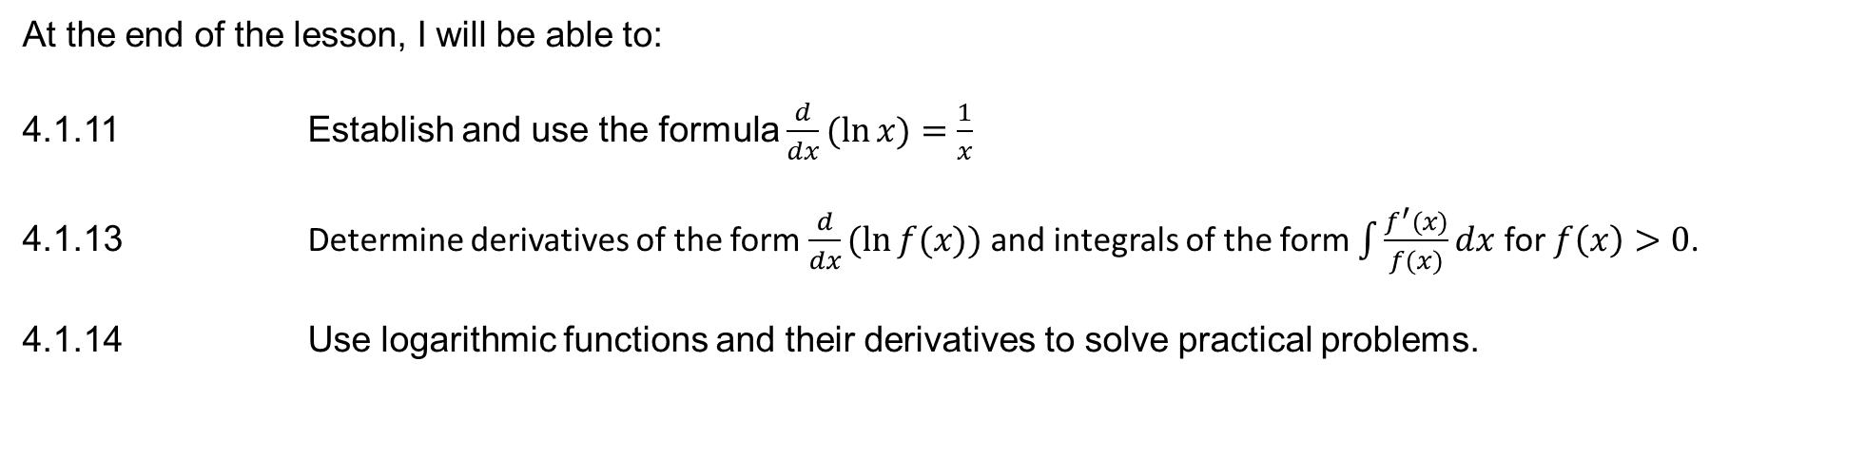
Learning Objective
I will be able to differentiate logarithmic functions to solve practical problems
Success Criteria
At the end of the lesson, I will be able to:
4.1.11 Establish and use the formula $\frac{d}{dx}(\ln{x)=\frac{1}{x}}$
4.1.13 Determine derivatives of the form $\frac{d}{dx}(\ln{f(x))}$ and integrals of the form $\int{\frac{f^{′}(x)}{f(x)}}dx$ for $f\left(x\right)>0$.
4.1.14 Use logarithmic functions and their derivatives to solve practical problems.

Slide 2
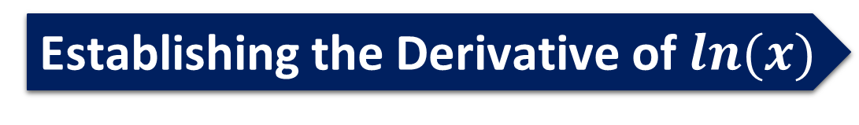
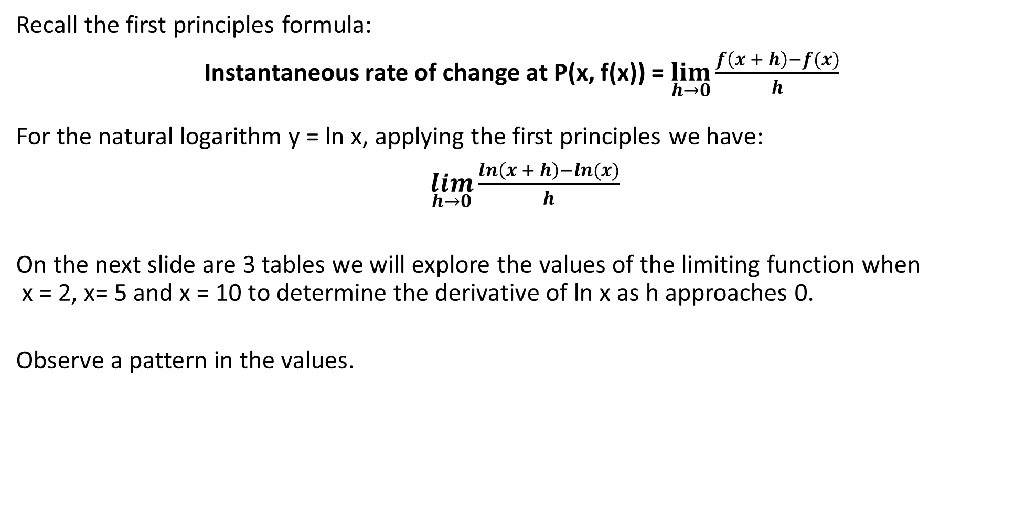
Establishing the Derivative of $ln(x)$
Recall the first principles formula:
Instantaneous rate of change at P(x, f(x)) = $\lim_{h→0}{\frac{f\left(x + h\right)−f(x)}{h}}$
For the natural logarithm y = ln x, applying the first principles we have:
$\lim_{h→0}{\frac{ln\left(x + h\right)−ln(x)}{h}}$
On the next slide are 3 tables we will explore the values of the limiting function when x = 2, x= 5 and x = 10 to determine the derivative of ln x as h approaches 0.
Observe a pattern in the values.

Slide 3
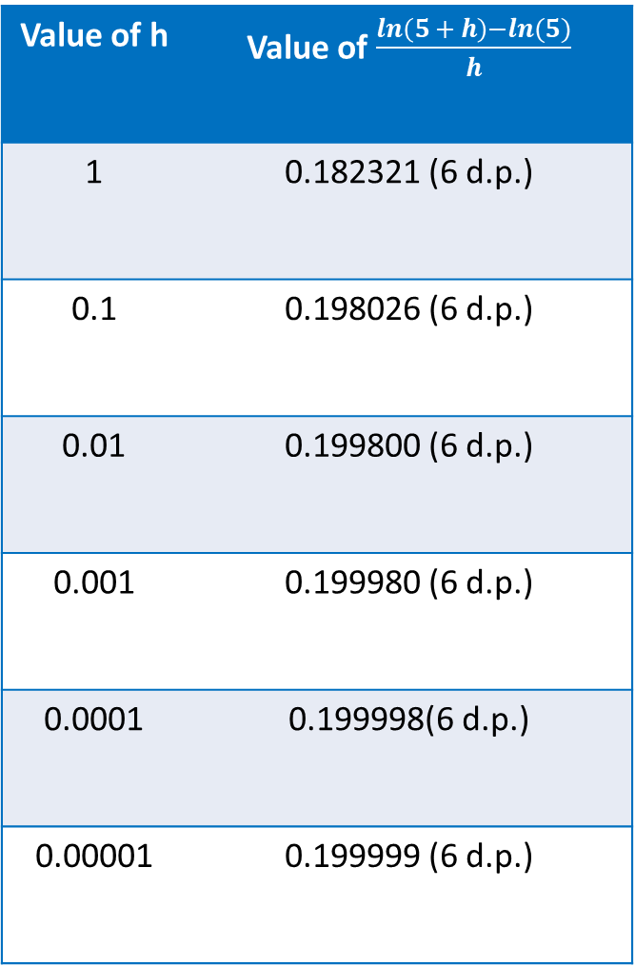
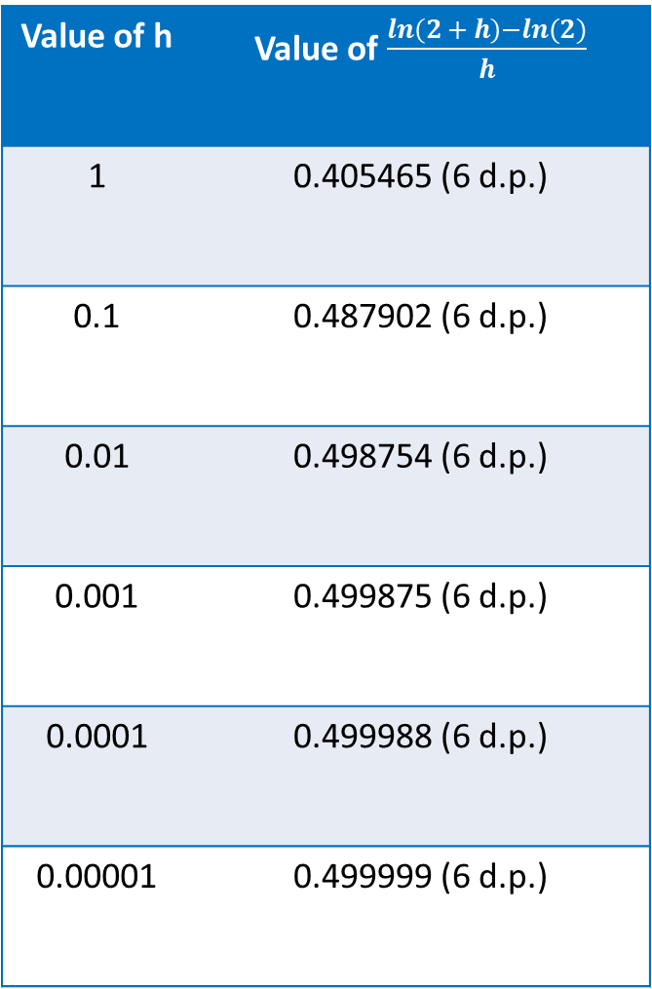
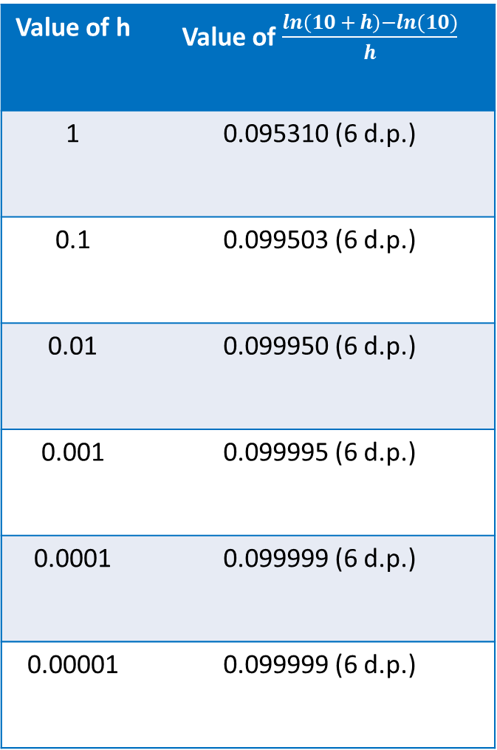
Establishing the Derivative of $ln(x)$
Value of h | Value of $\frac{ln\left(2 + h\right)−ln(2)}{h}$
1 | 0.405465 (6 d.p.)
0.1 | 0.487902 (6 d.p.)
0.01 | 0.498754 (6 d.p.)
0.001 | 0.499875 (6 d.p.)
0.0001 | 0.499988 (6 d.p.)
0.00001 | 0.499999 (6 d.p.)
Value of h | Value of $\frac{ln\left(5 + h\right)−ln(5)}{h}$
1 | 0.182321 (6 d.p.)
0.1 | 0.198026 (6 d.p.)
0.01 | 0.199800 (6 d.p.)
0.001 | 0.199980 (6 d.p.)
0.0001 | 0.199998(6 d.p.)
0.00001 | 0.199999 (6 d.p.)
Value of h | Value of $\frac{ln\left(10 + h\right)−ln(10)}{h}$
1 | 0.095310 (6 d.p.)
0.1 | 0.099503 (6 d.p.)
0.01 | 0.099950 (6 d.p.)
0.001 | 0.099995 (6 d.p.)
0.0001 | 0.099999 (6 d.p.)
0.00001 | 0.099999 (6 d.p.)

Slide 4
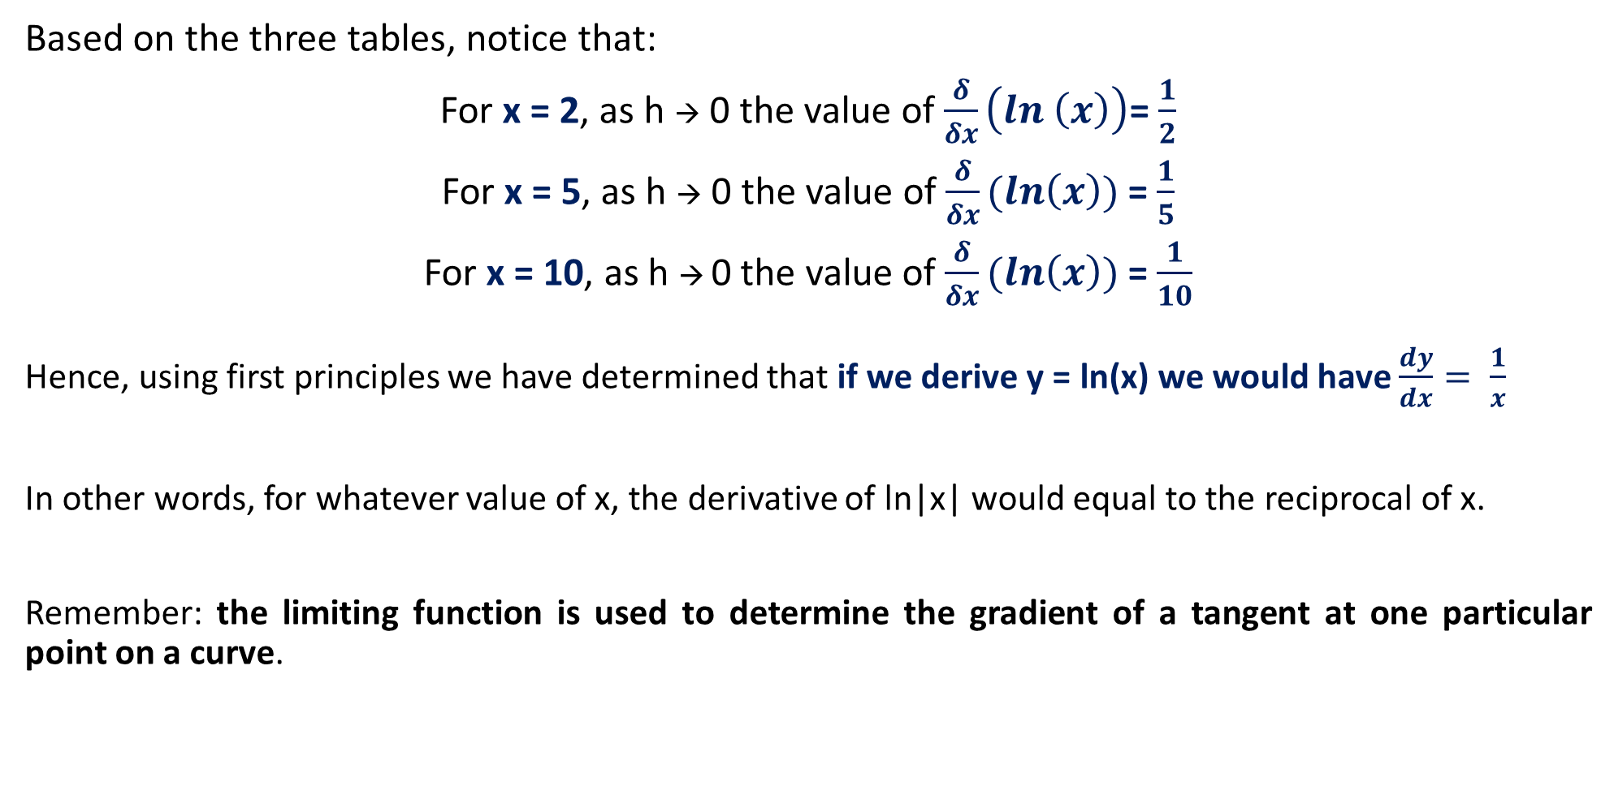
Establishing the Derivative of $ln(x)$
Based on the three tables, notice that:
For x = 2, as h → 0 the value of $\frac{δ}{δx}\left(ln \left(x\right)\right)$= $\frac{1}{2}$
For x = 5, as h → 0 the value of $\frac{δ}{δx}(ln\left(x\right))$ = $\frac{1}{5}$
For x = 10, as h → 0 the value of $\frac{δ}{δx}(ln\left(x\right))$ = $\frac{1}{10}$
Hence, using first principles we have determined that if we derive y = ln(x) we would have $\frac{dy}{dx}= \frac{1}{x}$
In other words, for whatever value of x, the derivative of ln|x| would equal to the reciprocal of x.
Remember: the limiting function is used to determine the gradient of a tangent at one particular point on a curve.

Slide 5
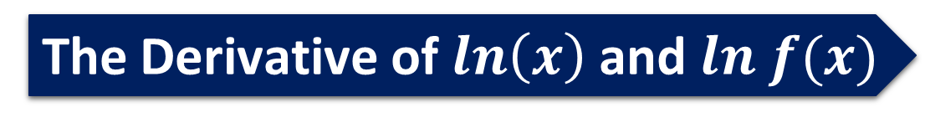

The Derivative of $ln\left(x\right)$ and $ln f(x)$
The derivative of the natural logarithmic function is given below:
If $y=\ln{(x)}$ $\frac{dy}{dx}=\frac{1}{x}$
And by the Chain Rule:
If $y=ln({f\left(x\right)})$ $\frac{dy}{dx}=f^{′}\left(x\right)×\frac{1}{f\left(x\right)}=\frac{f^{′}(x)}{f(x)}$

Slide 6

Guided Practice
Determine the derivative of $y =ln (2x)$
$$\frac{dy}{dx}=\frac{1}{x}$$
Determine the derivative of $y =5x^{2}+ ln (x)$
$$\frac{dy}{dx}=10x+ \frac{1}{x}$$

Slide 7

Guided Practice
Determine the derivative of $y=\ln\left(\frac{x}{x^{2}−1}\right)$
Rewrite $y=\ln\left(\frac{x}{x^{2}−1}\right)=\ln{(x)}−\ln\left(x^{2}−1\right)$← DO NOT USE THE QUOTIENT RULE. Apply Log Laws first
$$\frac{dy}{dx}=\frac{1}{x}−\frac{2x}{x^{2}−1}$$
$$=\frac{x^{2}−1 − 2x^{2}}{x(x^{2}−1)}$$
$$=\frac{−1 − x^{2}}{x(x^{2}−1)}$$
$$=\frac{−(x^{2}+ 1)}{−(x({1−x}^{2})}$$
$$=\frac{x^{2}+ 1}{x({1 − x}^{2})}$$

Slide 8



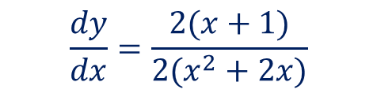
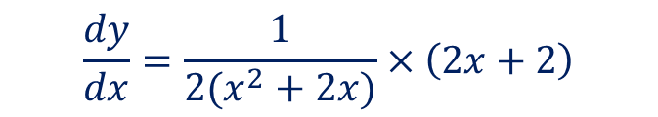
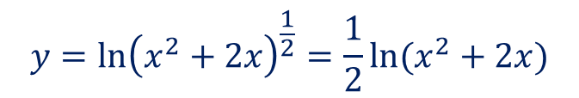
Guided Practice
Differentiate with respect to $x$:
a) $y=\ln\left(1+x^{3}\right)$
b) $y=\ln{\sqrt{x^{2}+2x}}$
$$\frac{dy}{dx}=\frac{3x^{2}}{1+x^{3}}$$
$$y=\ln{{\left(x^{2}+2x\right)}^{\frac{1}{2}}=\frac{1}{2}\ln{(x^{2}+2x)}}$$
$$\frac{dy}{dx}=\frac{1}{2(x^{2}+2x)}×\left(2x+2\right)$$
$$\frac{dy}{dx}=\frac{2(x+1)}{2(x^{2}+2x)}$$
$$\frac{dy}{dx}=\frac{x+1}{x^{2}+2x}$$

Slide 9

Guided Practice
Differentiate with respect to $x$:
$$y=ln{[{\left(x+1\right)}^{2}{\left(2x−1\right)}^{3}]}$$
$$y=ln (x+1)^{2}+ln (2x−1)^{3}$$
$$y=2ln (x+1)^{ }+3ln (2x−1)^{ }$$
$$\frac{dy}{dx}=\frac{2}{x+1}+\frac{6}{2x−1}=\frac{10x+4}{(x+1)(2x−1)}$$

Slide 10

Guided Practice
Differentiate with respect to $x$:
$$y=\frac{\ln{x}}{x}$$
By the Quotient Rule:
$$\frac{dy}{dx}=\frac{x×\frac{1}{x}−(ln x)}{x^{2}}$$
$$\frac{dy}{dx}=\frac{1−ln x}{x^{2}}$$

Slide 11

Guided Practice
Find the equation of the tangent to the given curve $y=\ln{x}$ at (1,0)
$$\frac{dy}{dx}=\frac{1}{x}$$
$$x=1, \frac{dy}{dx}=1$$
$$y=x+c$$
$$\left(1,0\right), c=−1$$
Therefore, t$he equation is y=x−1$

Slide 12

Guided Practice
Find the coordinates of the point(s) on the curve $y=x^{2}\ln{x}$ where the gradient of the curve is zero.
By the Product Rule:
$$\frac{dy}{dx}=2x ln x+x^{2}×\frac{1}{x}$$
$$\frac{dy}{dx}=2x ln x+x$$
$$\frac{dy}{dx}=x(2 ln x+1)$$
$$\frac{dy}{dx}=0, 0=x(2 ln x+1)$$
$x=0$ or $\frac{1}{\sqrt{e}}$
Reject $x=0$ as $\ln{(0)}$ is undefined.
$∴$ the coordinates of the point where the gradient is zero is $(\frac{1}{\sqrt{e}},−\frac{1}{2e})$

Slide 13
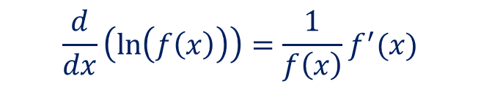
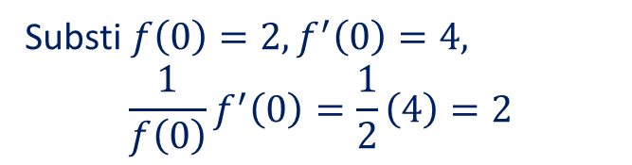
Guided Practice
Given that $f\left(0\right)=2$ and $f′\left(0\right)=4$, find $\frac{d}{dx}\left(\ln\left(f\left(x\right)\right)\right)$ where $x=0$.
$$\frac{d}{dx}\left(\ln\left(f\left(x\right)\right)\right)=\frac{1}{f\left(x\right)}f^{′}(x)$$
Substi $f\left(0\right)=2, f^{′}\left(0\right)=4,$ $$\frac{1}{f\left(0\right)}f^{′}\left(0\right)=\frac{1}{2}\left(4\right)=2$$

Slide 14
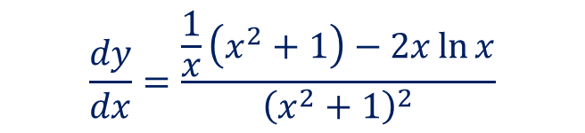

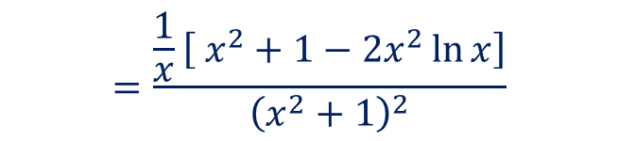
Guided Practice
Given $f\left(x\right)=\frac{\ln{x}}{x^{2}+1}$, determine $f^{′}\left(x\right)$
$$\frac{dy}{dx}=\frac{\frac{1}{x}\left(x^{2}+1\right)−2x\ln{x}}{{\left(x^{2}+1\right)}^{2}}$$
$$=\frac{\frac{1}{x}\left[ x^{2}+1−2x^{2}\ln{x}\right]}{{\left(x^{2}+1\right)}^{2}}$$
$$=\frac{x^{2}−2x^{2}\ln{x}+1}{{x\left(x^{2}+1\right)}^{2}}$$

Slide 15
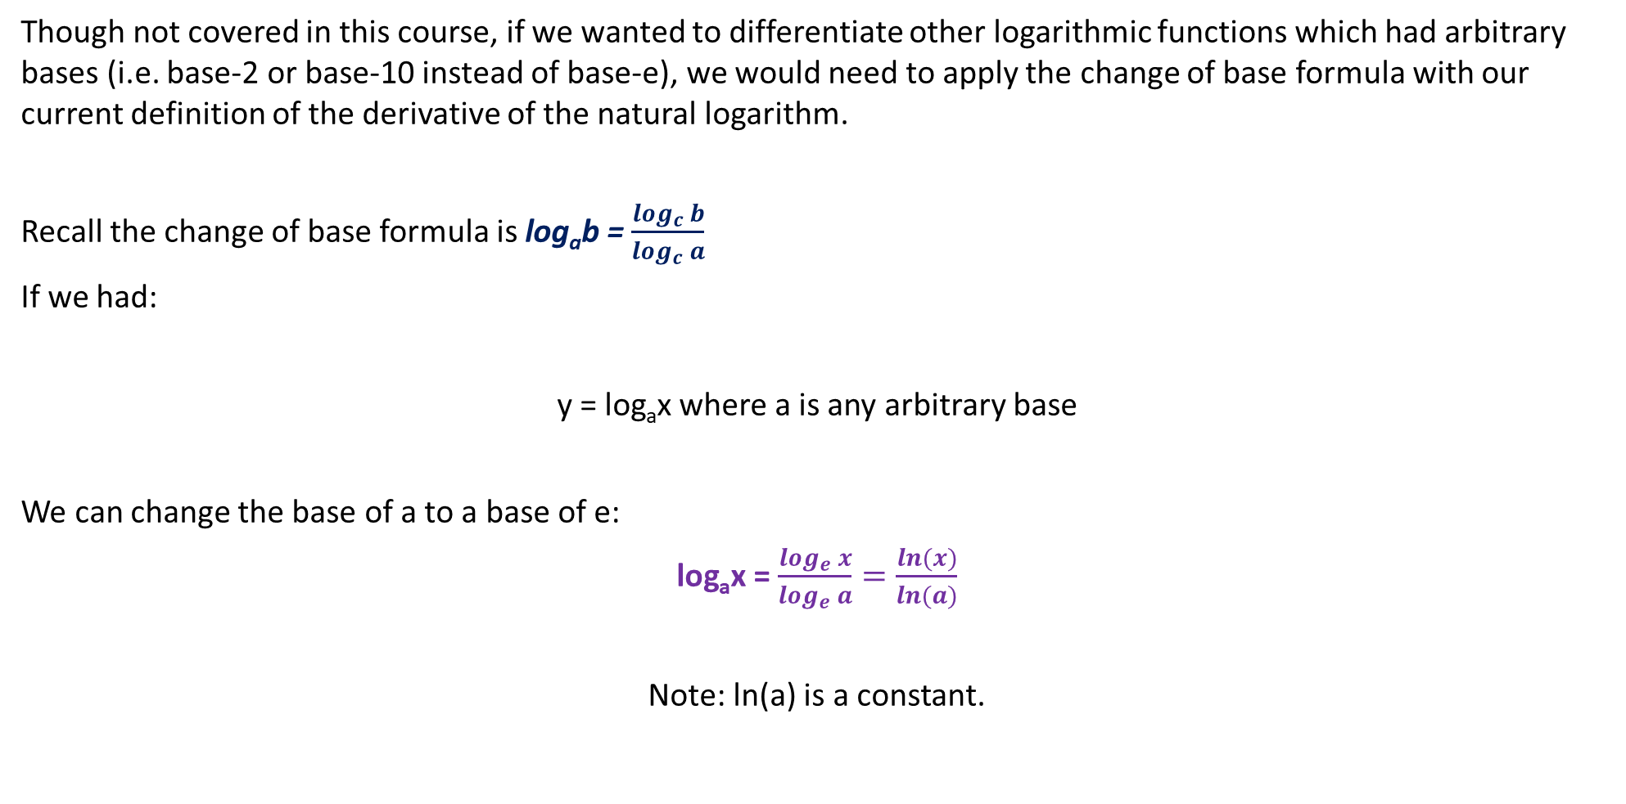
Derivatives of Logarithms of Other Bases (OFF THE COURSE)
Though not covered in this course, if we wanted to differentiate other logarithmic functions which had arbitrary bases (i.e. base-2 or base-10 instead of base-e), we would need to apply the change of base formula with our current definition of the derivative of the natural logarithm.
Recall the change of base formula is log_{a}b = $\frac{\log_{c} b}{\log_{c} a}$
If we had:
y = log_{a}x where a is any arbitrary base
We can change the base of a to a base of e:
log_{a}x = $\frac{\log_{e} x}{\log_{e} a}=\frac{ln(x)}{ln(a)}$
Note: ln(a) is a constant.

Slide 16

Derivatives of Logarithms of Other Bases (OFF THE COURSE)
If $\log_{a}$x $= \frac{1}{ln(a)}×ln\left(x\right),$
the derivative of $\log_{a}$x = $\frac{1}{ln(a)}×\frac{1}{x}$
If $y=\log_{a}\left(f\left(x\right)\right)$, then changing base to natural logs is:
$$y= \log_{a}\left(f\left(x\right)\right)=\frac{1}{\ln\left(a\right)}×\ln\left[f\left(x\right)\right]$$
Its derivative will be:
$$\frac{dy}{dx}= \frac{1}{ln(a)}×\frac{f^{′}(x)}{f\left(x\right)}$$

Slide 17
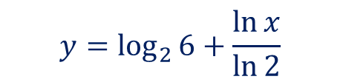
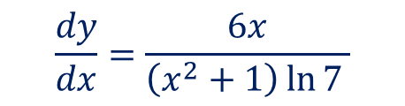

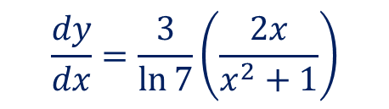
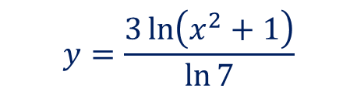

Derivatives of Logarithms of Other Bases (OFF THE COURSE)
Determine the derivative of y = log₂6x
Determine the derivative of y = 3 log₇(x² + 1)
$$y=\log_{2}{6}+\log_{2}{x}$$
$$y=\log_{2}{6}+\frac{\ln{x}}{\ln{2}}$$
$$\frac{dy}{dx}=\frac{1}{\ln{2}}×\frac{1}{x}$$
$$y=\frac{3\ln\left(x^{2}+1\right)}{\ln{7}}$$
$$\frac{dy}{dx}=\frac{3}{\ln{7}}\left(\frac{2x}{x^{2}+1}\right)$$
$$\frac{dy}{dx}=\frac{6x}{\left(x^{2}+1\right)\ln{7 }}$$

Slide 18
Independent Practice
Complete Ex 4H, 4J – L, 5D - E

